Slide 1
ENSE 374, Milestone 3
Software Group B
Avery, Nic, Jinkai, Jiahao, Renz, Mckenzie
October 30, 2018

Slide 2
Intro
Substance:
Content intended for Faculty & Staff
Forms, research, committees, events/meetings, courses
Structure:
The intranet will be organized into the main categories listed
Priority will be on easy navigation and frequently used processes
Workflow:
Separation by faculty (& committees if needed)
Ability to search, ability to search subsections
Dropdowns vs side bars
Governance:
Archival of old forms
Security - who gets access to what
Make sure changes go over well after implementation
Notes:
For our Content Strategy, we started by addressing all 4 parts individually, all parts are included in the structure portion as well.
Substance:
Content is intended for Faculty and Staff only, no students or unauthorized members will see the intranet side
The intranet will include content on Forms, Research, Committees, events, courses and faculty
Workflow:
The site organization seeks to be intuitive and quick to navigate through as requested by Meigen and Robyn.
This is done through Seperation of items by faculty, and the ability to search and sort content
We addressed the possibility of drop downs for quick navigation down the branches, this may not be possible with the current system so we opted for sidebars and clicking although dropdowns could be added if possible
Governance:
Archival of old forms was addressed by Meigen and having a naming conventions based on year could be helpful
Security in the site is a concern on the faculty side and the IT side,
content must be secure so as not to release confidential information while being manageable for IT
Separation by Faculty is our current method with content being locked (links visible but not accessible) if a user does not have access.
This makes it secure but allows a person who does not have security access to know what clearances they should request more easily.
A review of what changes have been made and how to complete common tasks would be helpful as well as address design concerns
Structure is described in our diagrams

Slide 3
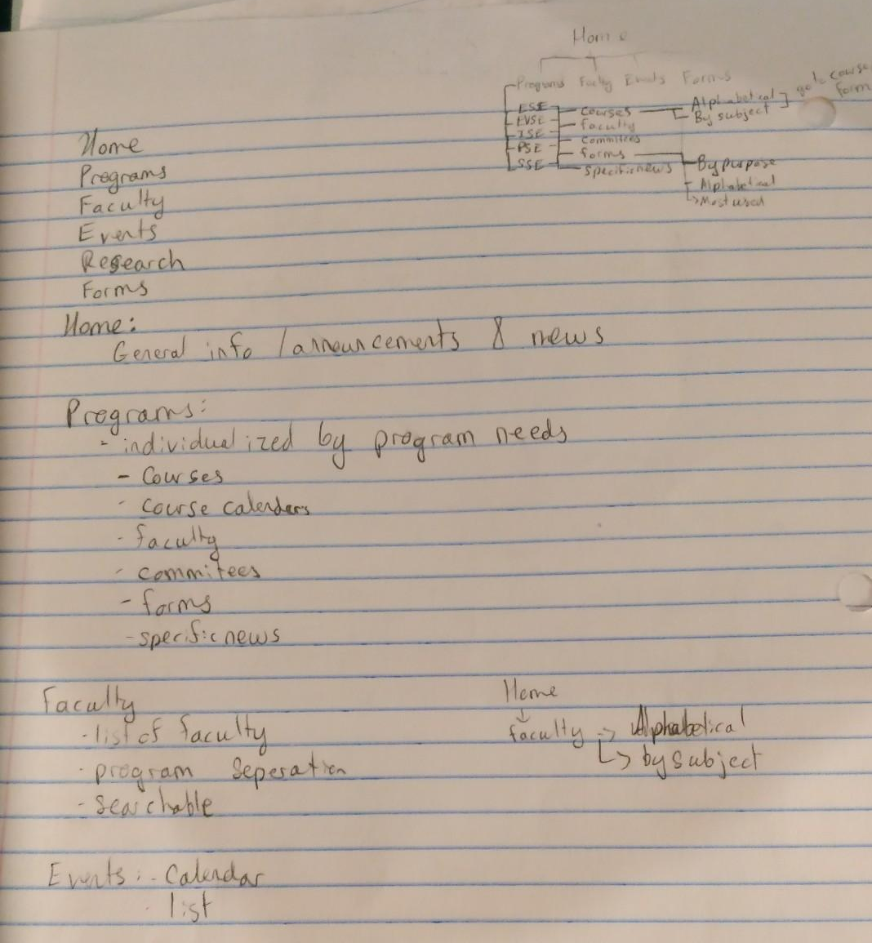
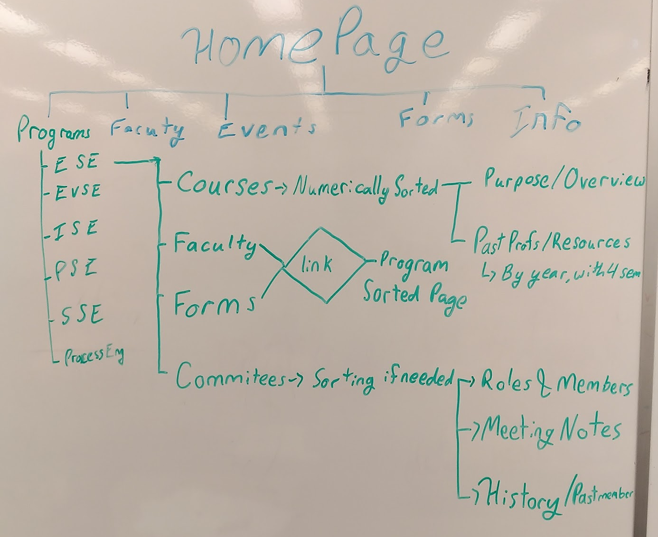
Process
Structure was created in a few steps:
Writing out on paper jot notes
Whiteboard implementation
Diagram Finalization
Notes:
Process:
Individually we each came up with main categories and subcategories, these changed a couple times and caused a redesign or removal of drawings
Next we drew out the organization on a whiteboard, we discussed what we wanted and erased and changed items as necessary
Then we finalized work and created generated diagrams
This process allowed for removal of items easily and ensured the decisions were thought out and purposeful
We organized categories to try and create an easy to navigate and intuitive system as requested by Meigen.

Slide 4
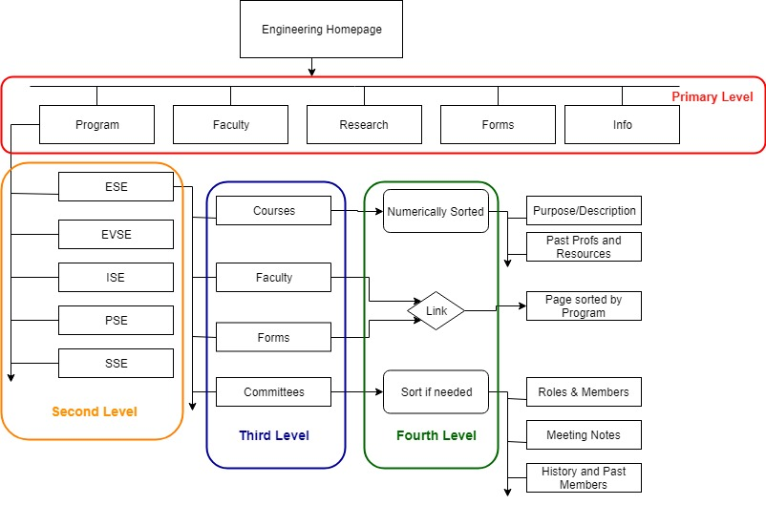
Programs
Each program has the same options
Sidebar links for navigation
Courses in numerical sort
Committees will be listed but access may be limited
Notes:
Avery:
Programs:
Each program has the same options, this allows consistency throughout the different programs
There will be side bars for navigation similar to the public site, with the implementation of drop downs if possible with the software for quicker navigation
Courses will be able to be searched through numerically, with options to jump to 100, 200, 300 etc level courses, this will list course info and have past profs separated by years with resources used.
For security in the courses portion of the site, security would be managed through program groups, each group would be able to see intended faculty content and committees although listed would only be accessible when the user is in the committee or has access to it.
The separation by faculty allows easy security management but also allows for easy access for faculty. This comes from Meigan wanting it to be easy to explain where to find content to other people, which is why we tried to keep subheadings low and intuitive and included navigation by side bars and sorting.

Slide 5
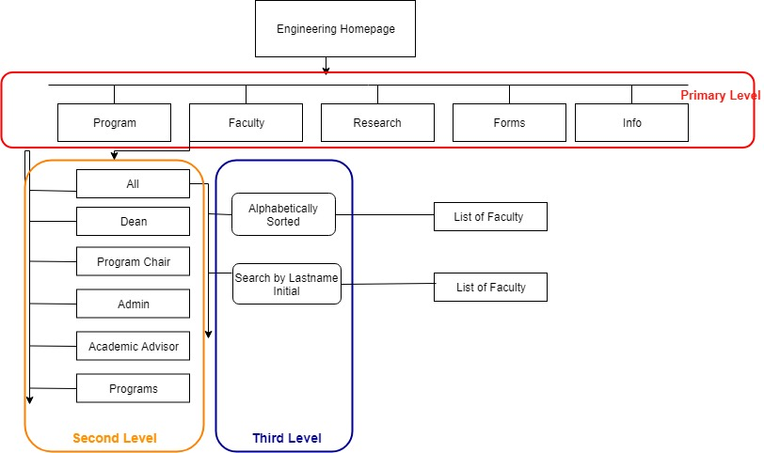
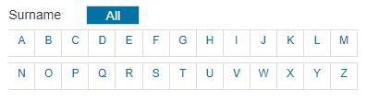
Faculty
Similar to public page organization
Sidebar for navigation
Ability to sort by last name
Notes:
Mckenzie
Faculty:
The Faculty page on the intranet will be similar to the one on the public page, a list of faculty members, their qualifications and contact information.
A search bar to skip to a person’s last name, will be implemented for easier searching and navigation through the page organization similar to the image above
This allows for the intuitive nature of navigation that Meigen requested and for consistency between the public and intranet sides

Slide 6
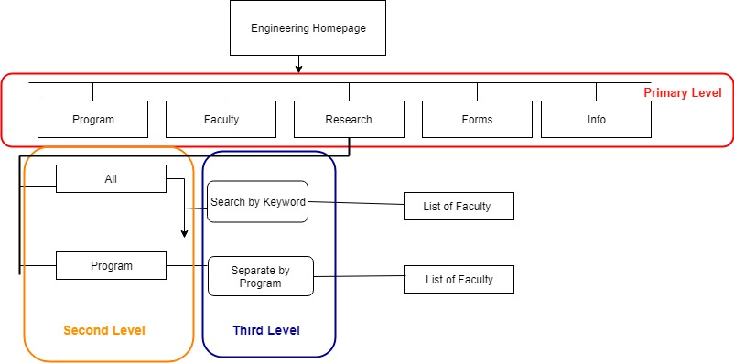
Research
This page was flagged for removal from the public site
Content:
Advertise what the University of Regina has to offer
Grid-based display of the different programs offered with links to the faculty members with
specific research
interests in the
associated field
Navigation bar update:
Hierarchical structure
of the links provided in
the page itself
Notes:
RENZ
In milestone 2, our group had decided to remove this page from the public mainly because its content didn’t seem to be necessary
but as of this milestone, we decided that the content is still needed to be included on the public site, with the implementation of the reorganization
The proposed content strategy
Content model
Basically have the page be its own main source instead of fully relying on other pages — making the page more necessary and again the overall website more user friendly and less confusing
Will lay out all the different programs in a grid like form that will have links to the faculty members with specific research interests in the associated field
It will be searchable, either by keyword or by the program
Navigation structure:
Aside from the page having its own informative navigational structure
It will still be included in the current side navigation bar for quicker access, having a hierarchical structure with the drop down containing the links to the faculty members with specific research interests in the associated fields as mentioned before
Research will be available to all staff, regardless of security to promote collaboration. Easy to navigate is key which is why the search function and categories are included.

Slide 7
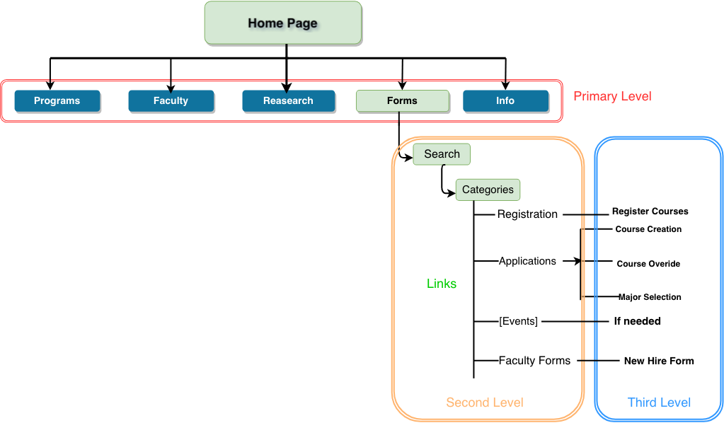
Forms
A searchable by keyword list
Category selections
-Registration: registration form of
programs
-Applications: course creation,
course override and
major selection
-[Events/Activities]: if needed
-Faculty Forms: new hire form
Notes:
Jiahao Li
Forms:
Inside the Forms section, a searchable keyword list will be provided. Also the results of searching are registration forms, applications forms, Events forms and faculty forms. For registration, there are registration form of all programs. For applications, there are course creation, course override and major selection. For events/activities, we added this section if needed means we think that the public site does not provide kind of forms of events. For faculty, there are new hire forms and other faculty forms.
The reason why we did that…
The search by keyword and having categories to select make the forms more searchable, this makes it easier to find and explain where forms are to others as Meigen mentioned would be helpful.
The system would be similar to the research page to ensure the system is easy to learn and use
Currently we have forms for registration and applications, this would generally be used by academic advisors and admin staff
Then we have faculty forms which could include the New Hire forms for example and other faculty specific forms

Slide 8
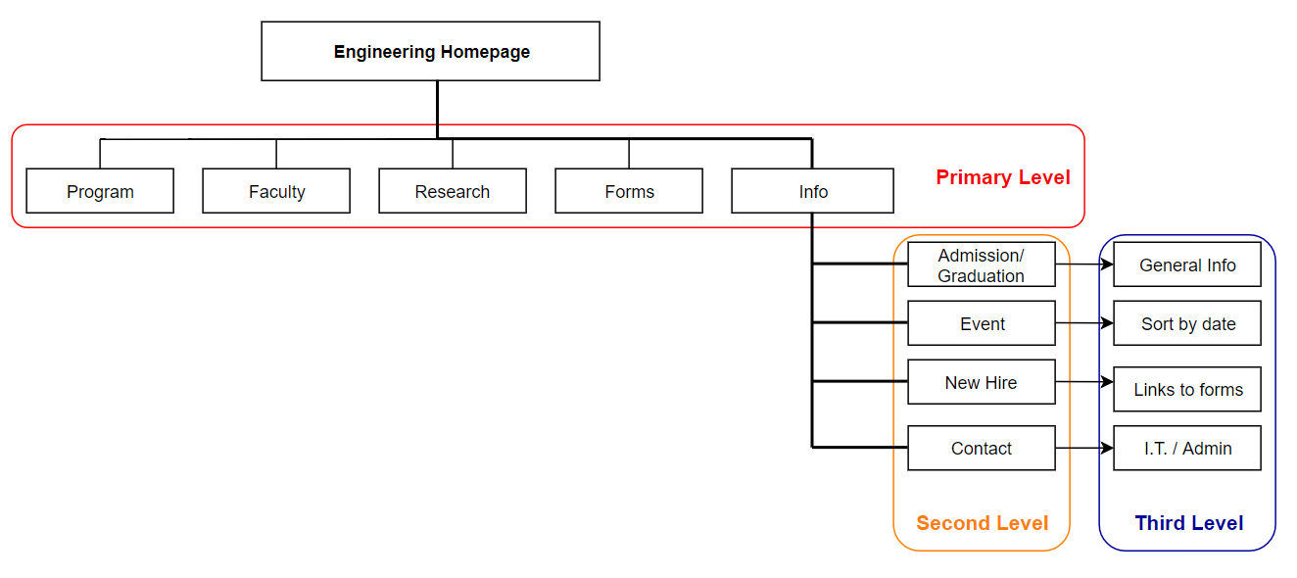
Info
Basic information about Admin & Grad
Events sorted systematically
Hire forms linked to “Forms” page
Solving technical/instructional issues by contacting relative department
Notes:
JINKAI
Info
When moving mouse on each corresponding tag, a sidebar will pop up showing information for navigating.
Admission and graduation tag illustrates basic information about Engineering programs for faculty.
Events can be sorted by date, for example, the latest one will be shown in the front.
And for having any issues related to technical matter or educational problems, contact bar is accessible for faculty to reach each department.
The contents of New Hire could just be a section in forms, however additional information and training could be provided using this separate link.
This is an area to display information that may hinder or have difficult navigation under other categories, this is to ensure the ease of use of the intranet for faculty and staff such as Meigen. Additional items could be added as necessary.

Slide 9
Group reflection
How did you feel about this milestone? What did you like about it? What did you dislike?
The biggest hurdle was being unable to access the intranet in order to to get an idea of how to organize it, but overall the milestone went well
What did you learn about yourself as you collaborated and worked through this milestone?
This was a tough milestone with midterms. The biggest thing was continuing to learn how to work around and with each others’ schedule
How will you use what you have learned going forward?
We will continue to assist others if needed and talk early and often to make sure if someone is busy they are still in the loop
What “stuff & things” related to this milestone would you want help with?
Access to intranet or more information on what content is there would be helpful
Notes:
Our biggest issue with this milestone was being unable to access the intranet site and see exactly what’s there in order to flesh-out our plans. However we do understand why we couldn’t access it and worked accordingly
Other than learning how to work with rough outlines of the data provided on the intranet side, we continued to learn how to work around and with each others’ schedules especially with it being midterm season currently
One of the biggest things to take away is to talk early and often. This way people who may not be present are still in the loop and can contribute ideas others may have missed.
Needing help might be a bad way to word it, but access to the intranet would have been nice with this milestone, not knowing what was there helped generate ideas we may have ignored if we had an idea of what already existed.

Slide 10
Questions?

